Slide 1
AI Model for Breast Cancer Detection
An Innovative Approach to Early Diagnosis
Supervision :Eng Sara Ashraf

Slide 2
Breast cancer
Breast cancer is a global health issue, affecting millions of people annually.
According to the World Health Organization (WHO), breast cancer is the most common cancer in women worldwide, both in developed and developing countries

Slide 3
:Intoduction
1-This code loads and processes medical images representing benign, normal, and malignant cells
It uses these images to train a deep learning model for classification using MobileNetV2.
2-Used LibrariesOpenCV (cv2):
For image processing.NumPy (np): For efficient data handling.scikit-learn (sklearn): For splitting the data into training and testing sets.TensorFlow (tf): For building and training the deep learning model.Matplotlib (matplotlib.pyplot): For plotting graphs.
3-. Loading and Labeling ImagesImages are loaded from different paths (benign_path, normal_path, malignant_path) and labeled based on their type (0: benign, 1: normal, 2: malignant).
4. Data PreparationData is split into training and testing data using train_test_split.A data generator (ImageDataGenerator) is prepared to augment data by performing transformations such as rotation, flipping, and zooming.
5. Model BuildingMobileNetV2 is used as the base model and is pre-trained, with its base layers frozen.Additional layers like convolutional and pooling layers, as well as dropout for regularization, are added to improve performance.The model is defined for categorical classification.
6. Training and EvaluationThe model is trained using the preprocessed data and the data generator (train_generator).The model is evaluated using the testing data, and both accuracy and loss are calculated.
7. OutputA summary of the model, including details about the layers and the number of parameters, is printed.The accuracy of the model on the testing data is printed.Predictions are made using the model on the testing data, and a classification report is generated by comparing the actual labels with the predicted labels

Slide 4
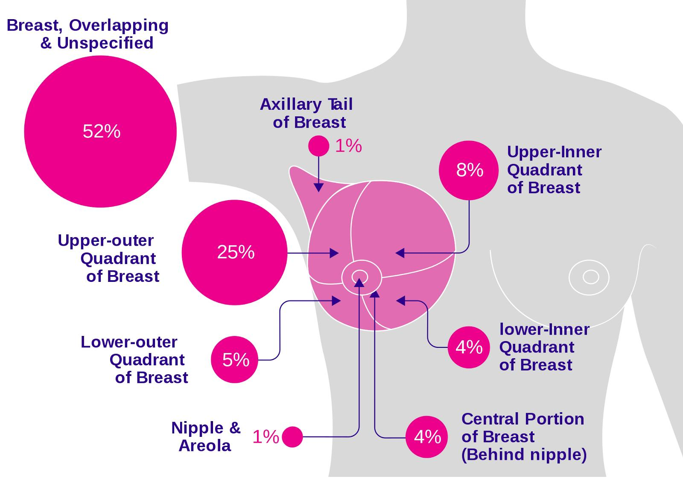
The importance of breast cancer detection and the need for accurate prediction models.

Slide 5
Types of tumor
Benign tumor
Non-cancerous
Capsulated
Slow Growing
Non-invasive
Malignant tumor
Cancerous
Non-capsulated
Fast growing
Cells have Large dark nuclei ; may have abnormal shape

Slide 6
Used Libraries
OpenCV (cv2): For image processing.
NumPy (np): For efficient data handling.
scikit-learn (sklearn): For splitting the data into training and testing sets.
TensorFlow (tf): For building and training the deep learning model.
Matplotlib (matplotlib.pyplot): For plotting graphs.

Slide 7
Loading and Labeling Images
Images are loaded from different paths (benign_path, normal_path, malignant_path) and labeled based on their type (0: benign, 1: normal, 2: malignant).

Slide 8
Data Preparation
Data is split into training and testing data using train_test_split.
A data generator (ImageDataGenerator) is prepared to augment data by performing transformations such as rotation, flipping, and zooming.

Slide 9
Model Building
MobileNetV2 is used as the base model and is pre-trained, with its base layers frozen.
Additional layers like convolutional and pooling layers, as well as dropout for regularization, are added to improve performance.
The model is defined for categorical classification.

Slide 10
Training and Evaluation
The model is trained using the preprocessed data and the data generator (train_generator).
The model is evaluated using the testing data, and both accuracy and loss are calculated.
Acceursy:
*train acceurcy➔90%
*validate acceurcy➔80%

Slide 11
summary of the model
A summary of the model, including details about the layers and the number of parameters, is printed.
The accuracy of the model on the testing data is printed.
Predictions are made using the model on the testing data, and a classification report is generated by comparing the actual labels with the predicted labels.

Slide 12
Thank you
Dalia hesham
Abdelrahman Mohamad
Habiba Mohamad Elnaggar

